Slide 1


Week 10
This Photo by Unknown Author is licensed under CC BY-SA
A recap and a short intro to logistic regression.
Let’s go METS!!!!!!

Slide 2
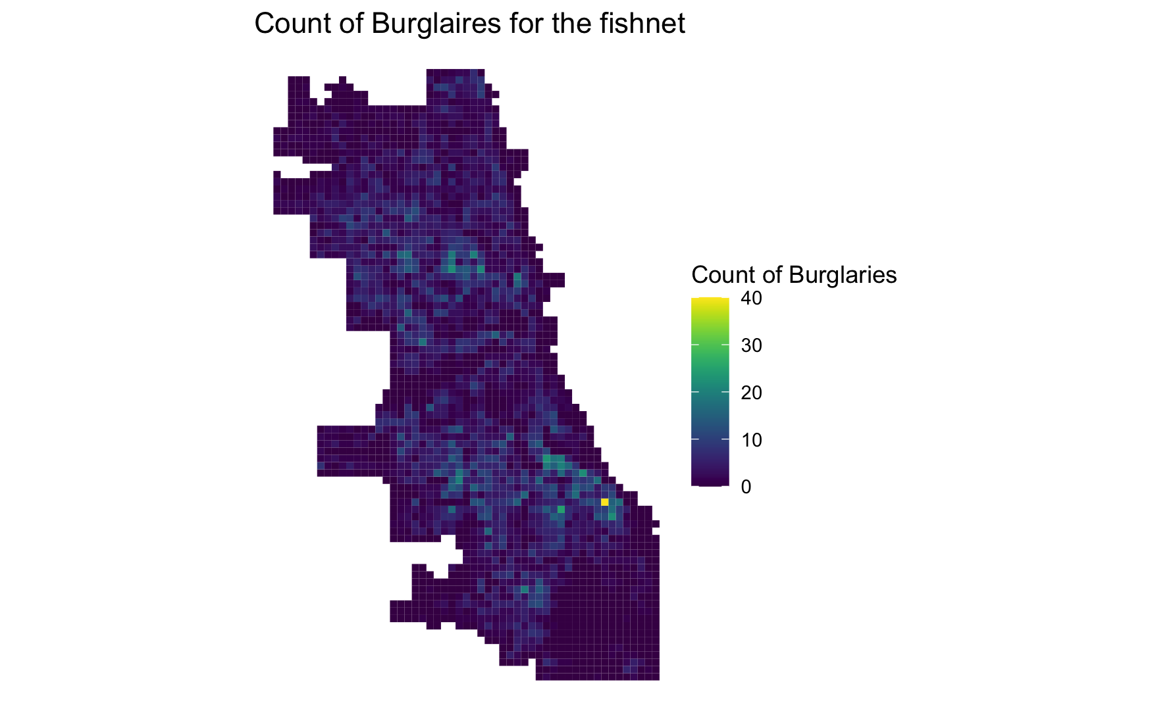
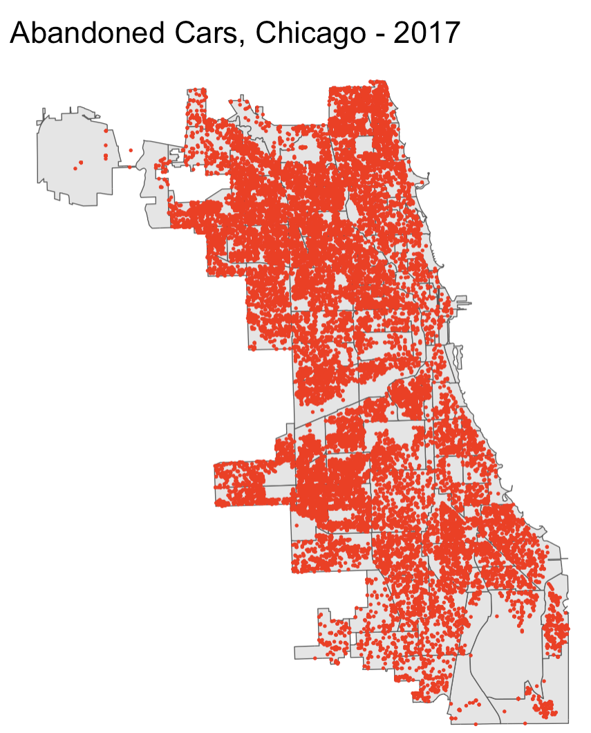
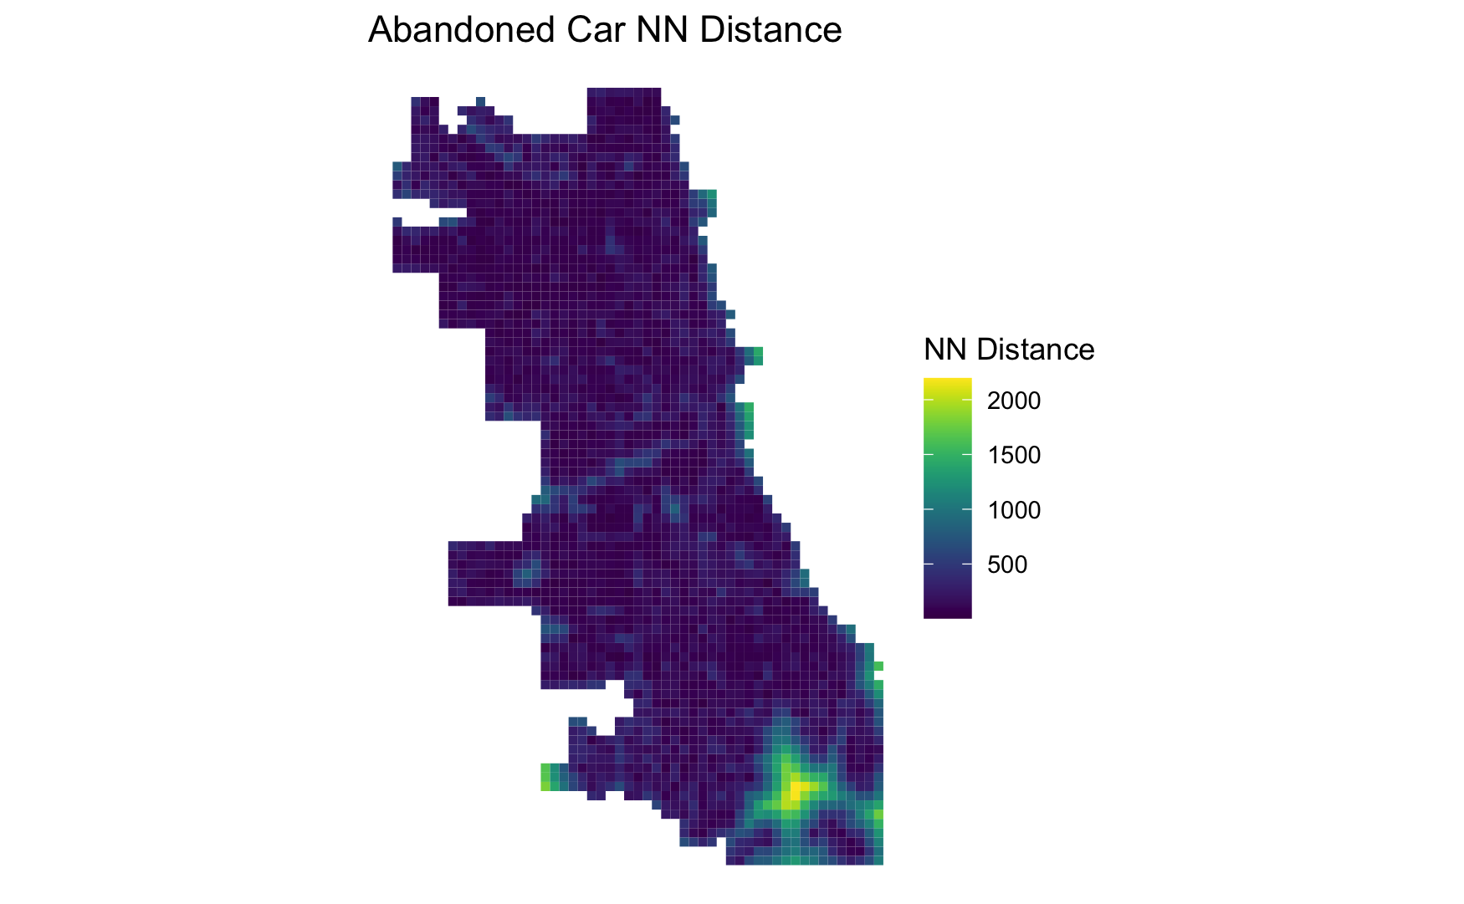
Recap A Bit for The Memory Loss\Those not here
Predicting Counts
Biased Data
Outcome Variable =
Count of Burglaries in Grid Cell
Predictor Variable =
Abandoned Cars (311 Calls)

Slide 3
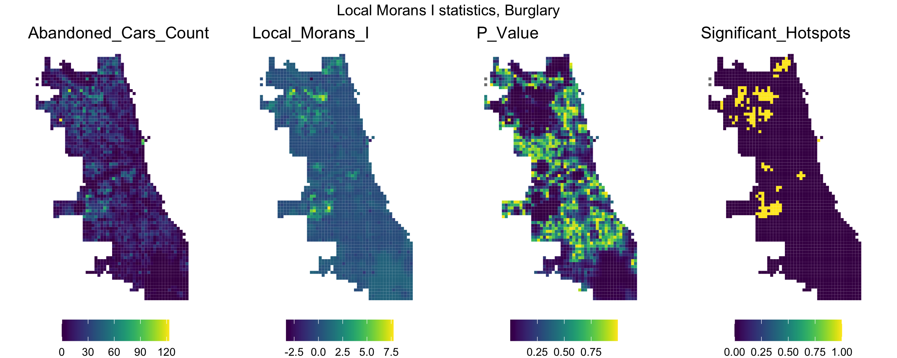
Local Moran’s I

Slide 4
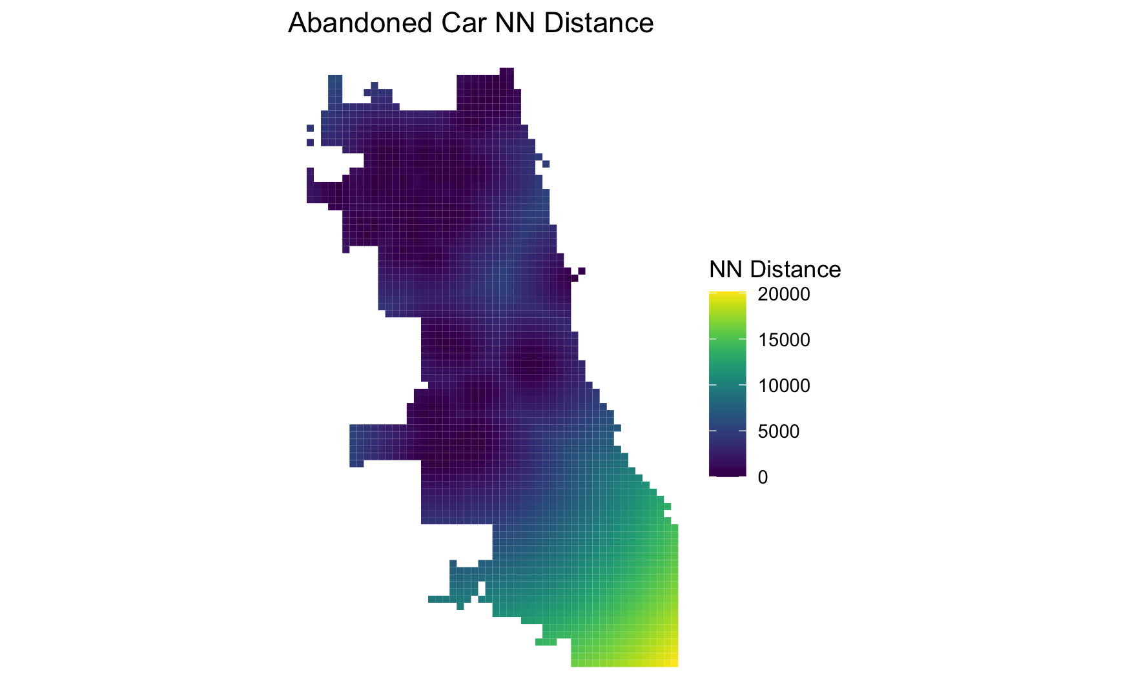
Distance to Nearest Hot Spot (k=1)

Slide 5
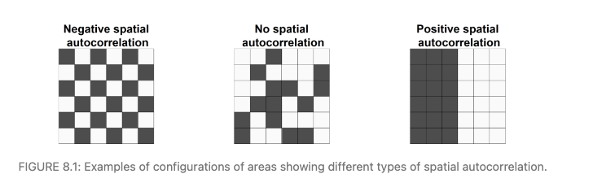
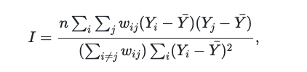
Recap a little.
Global Moran’s I
https://www.paulamoraga.com/book-spatial/spatial-autocorrelation.html

Slide 6
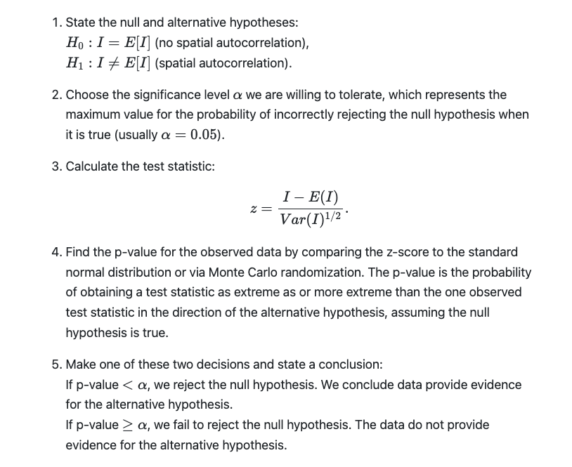
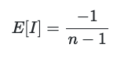
Testing
https://www.paulamoraga.com/book-spatial/spatial-autocorrelation.html

Slide 7
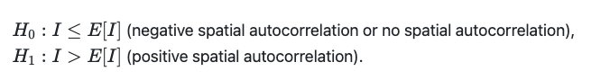
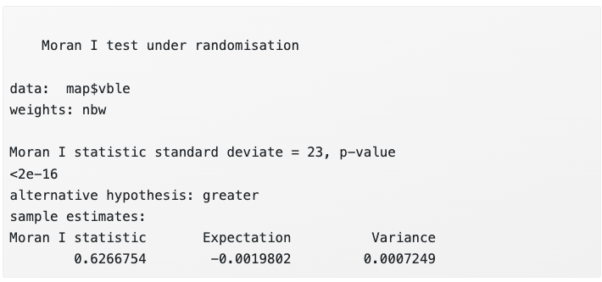
moran.test() in spdep package
moran.test
numeric vector with data
list with spatial weights
type of hypothesis (alternative)
# Neighbors
library(spdep)
nb <- poly2nb(map, queen = TRUE) # queen shares point or border
nbw <- nb2listw(nb, style = "W")
# Global Moran's I
gmoran <- moran.test(map$vble, nbw,
alternative = "greater")

Slide 8
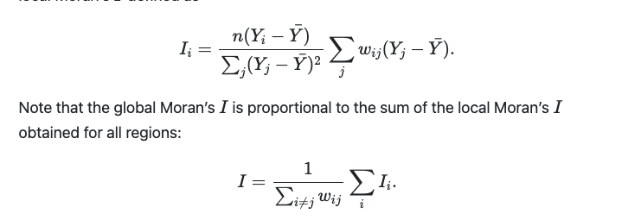
Local Moran’s I
High value:
area surrounded by areas with similar values (high or low).
Low value:
area surrounded by areas with dissimilar values.
Outlier. Observation different from everyone else around it.

Slide 9
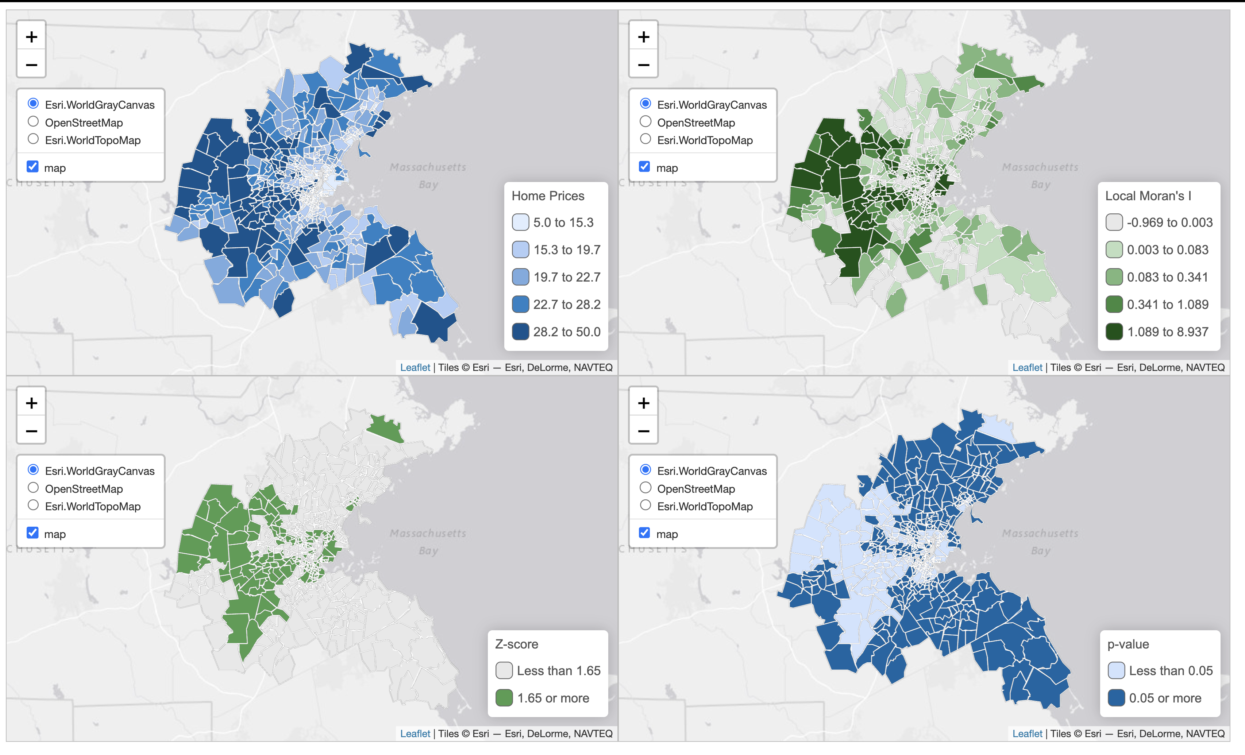

Slide 10
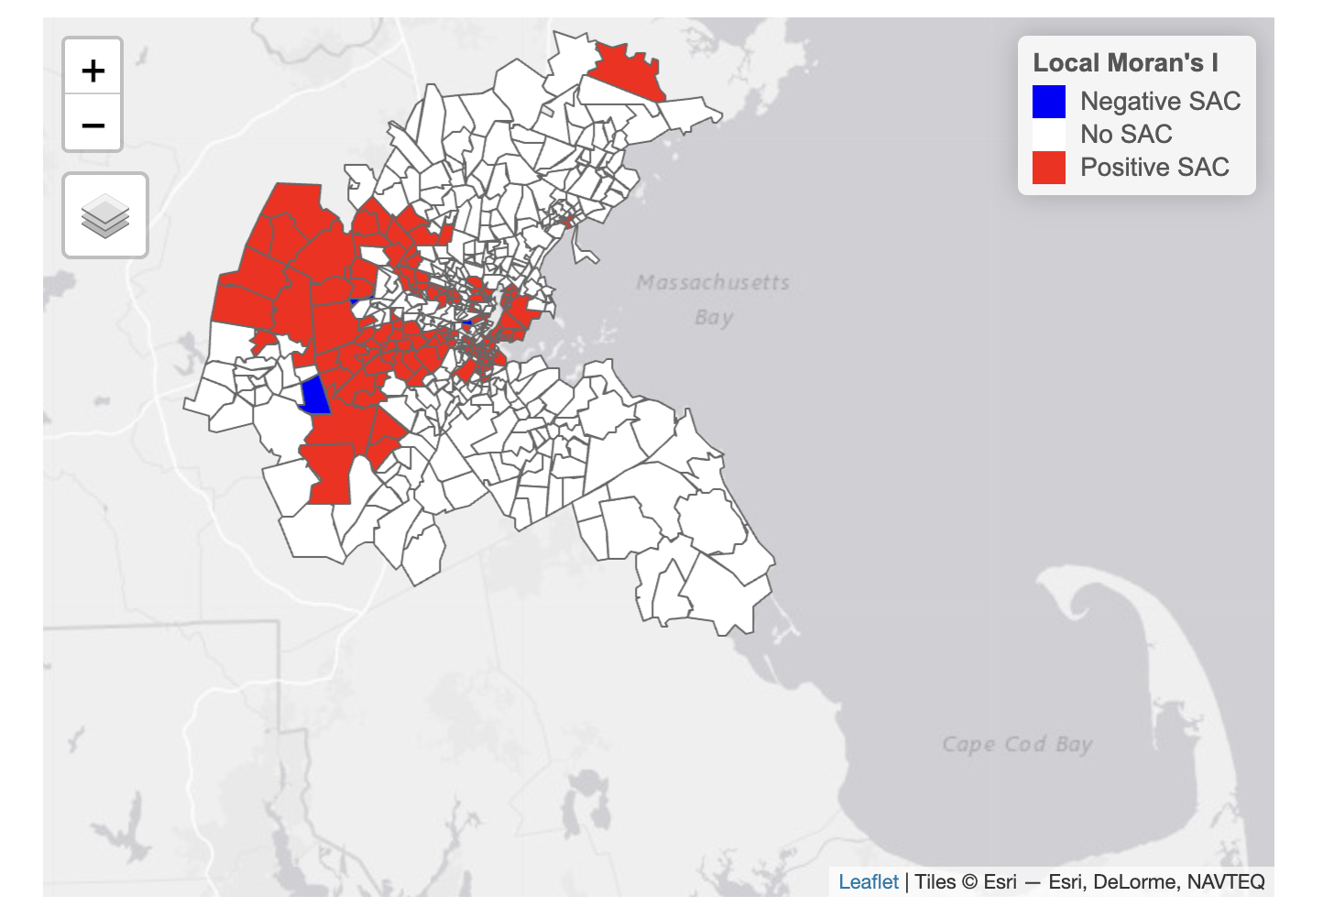
Mapping Positive and Negative S.A.
tw0-sided test.
Filter z-score values above and below 1.96 (95% confidence).

Slide 11
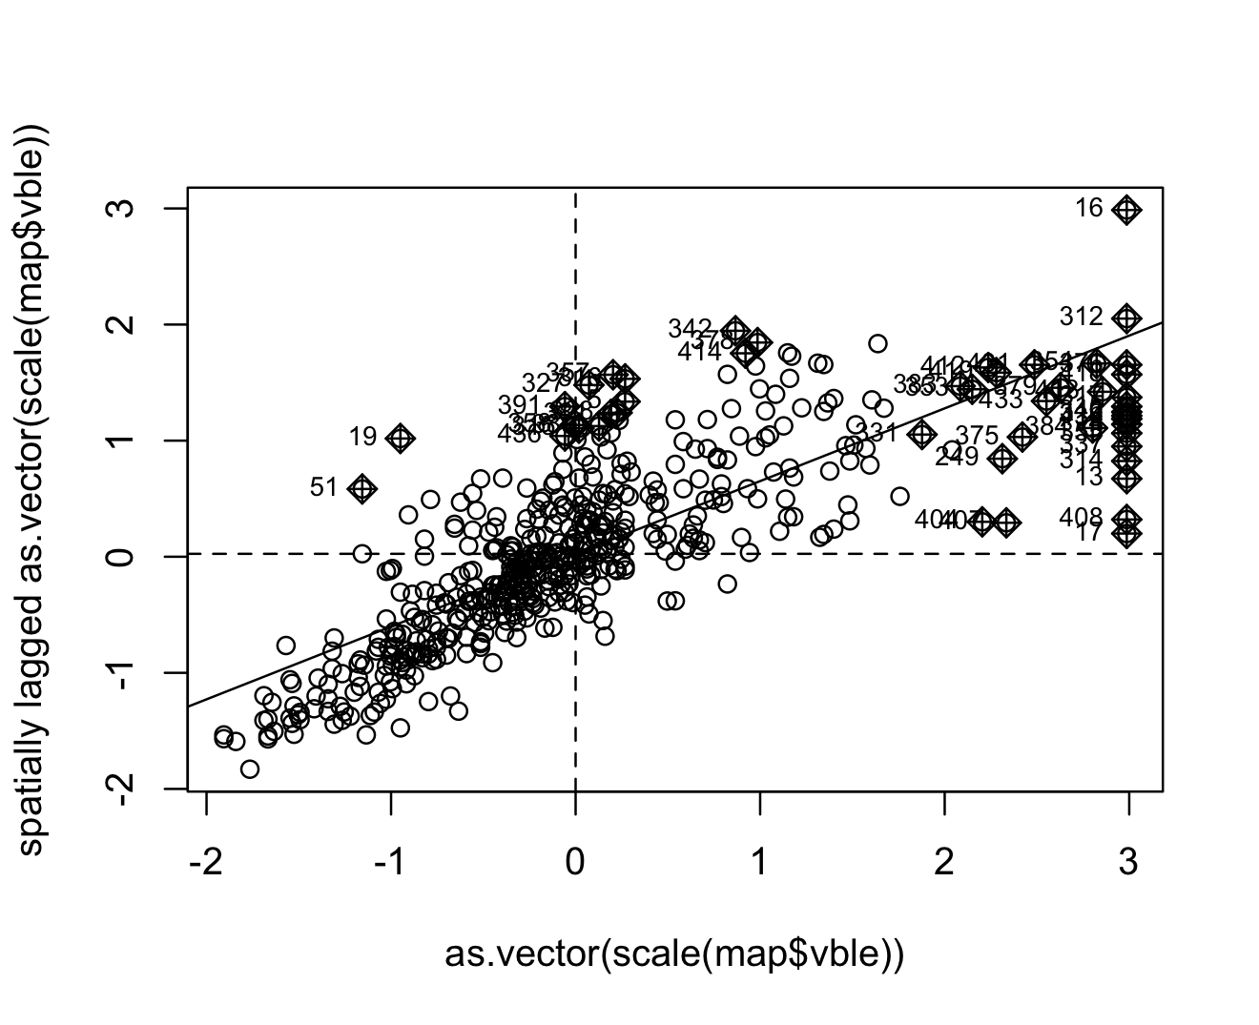
Mapping Clusters
Which quadrant is it in AND is it significant (p<0.05)
Local Moran’s I allows us to identify clusters of the following types:
High-High: areas of high values with neighbors of high values,
High-Low: areas of high values with neighbors of low values,
Low-High: areas of low values with neighbors of high values,
Low-Low: areas of low values with neighbors of low values.
LH
HH
LL
HL

Slide 12
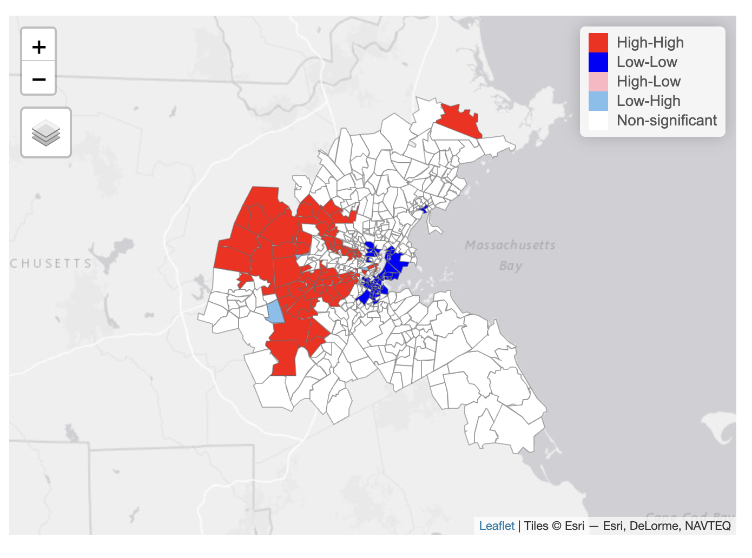

Slide 13
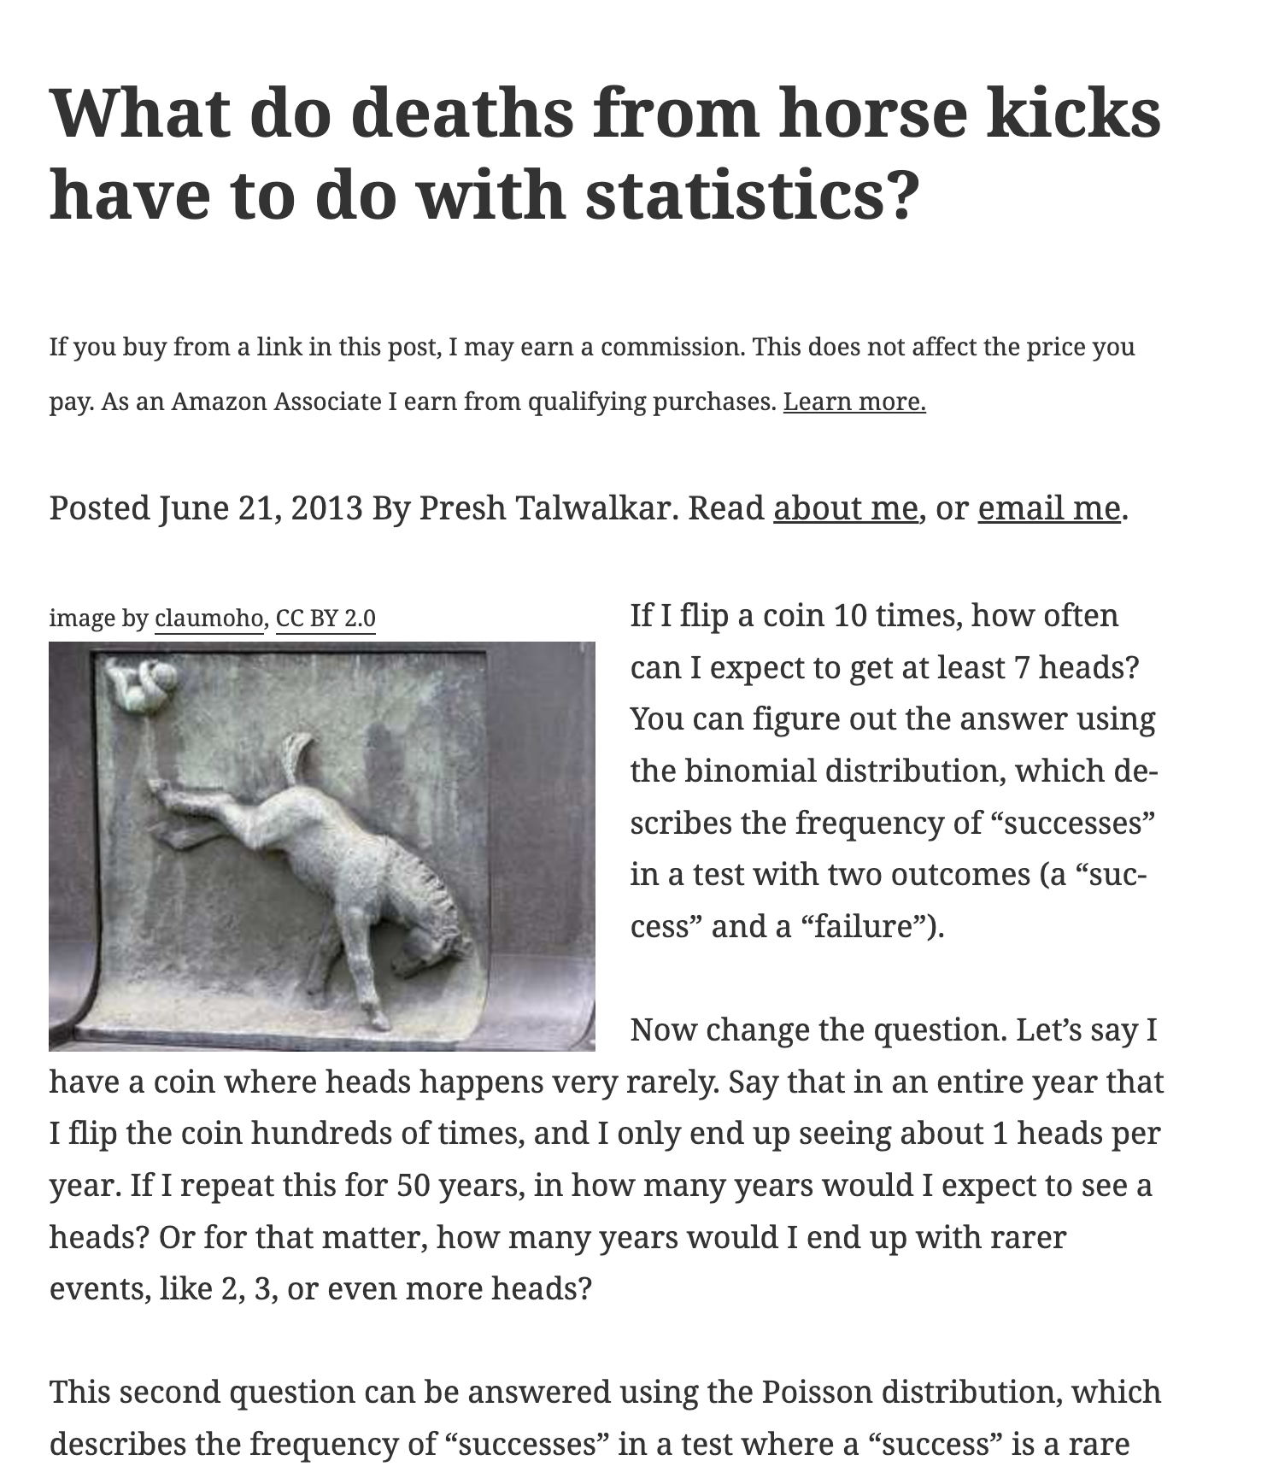
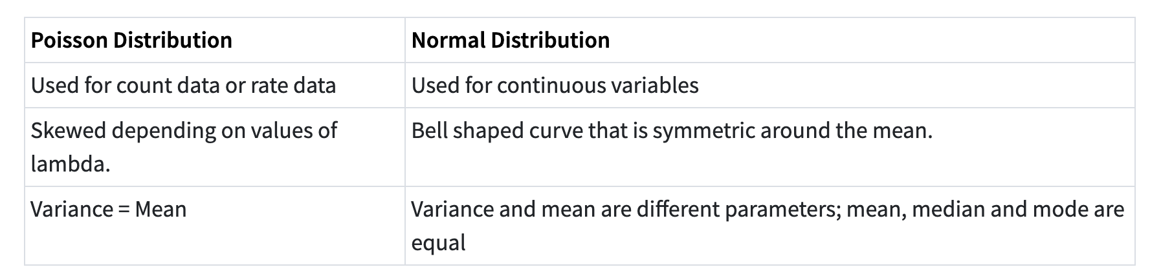
Poisson Regression

Slide 14
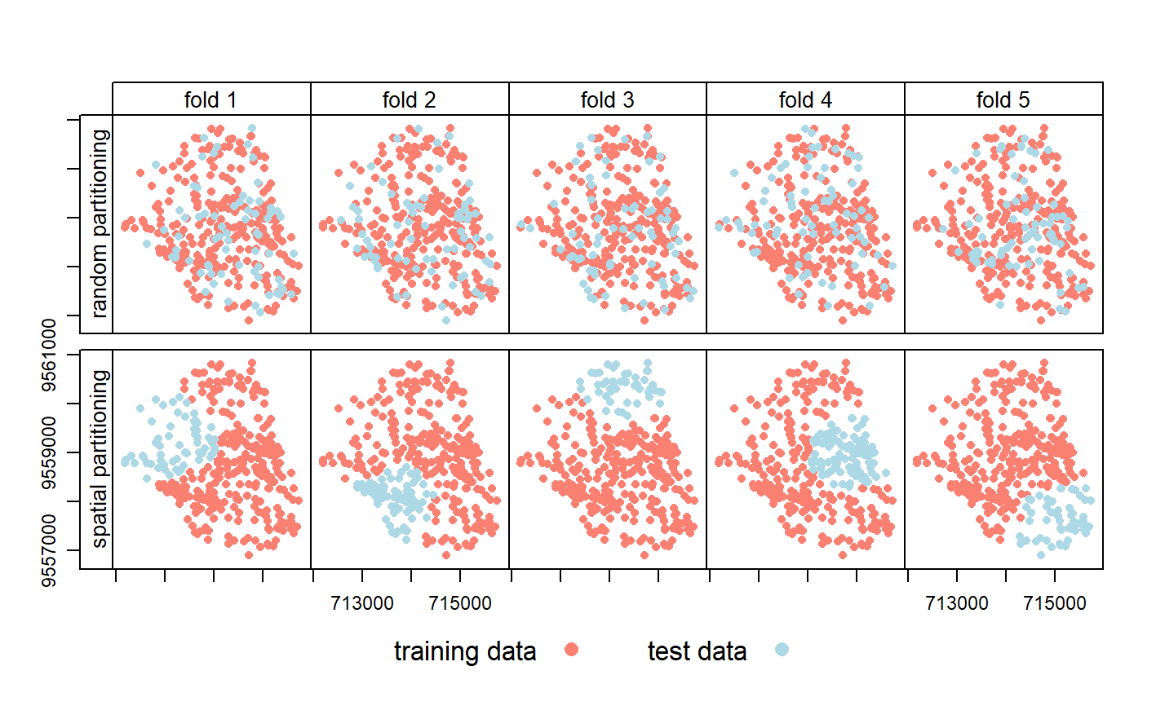
Geographic Cross-Validation
Spatial Autocorrelation
Spatial Generalizability
Spatial Leakage
https://bookdown.org/robinlovelace/geocompr/spatial-cv.html

Slide 15
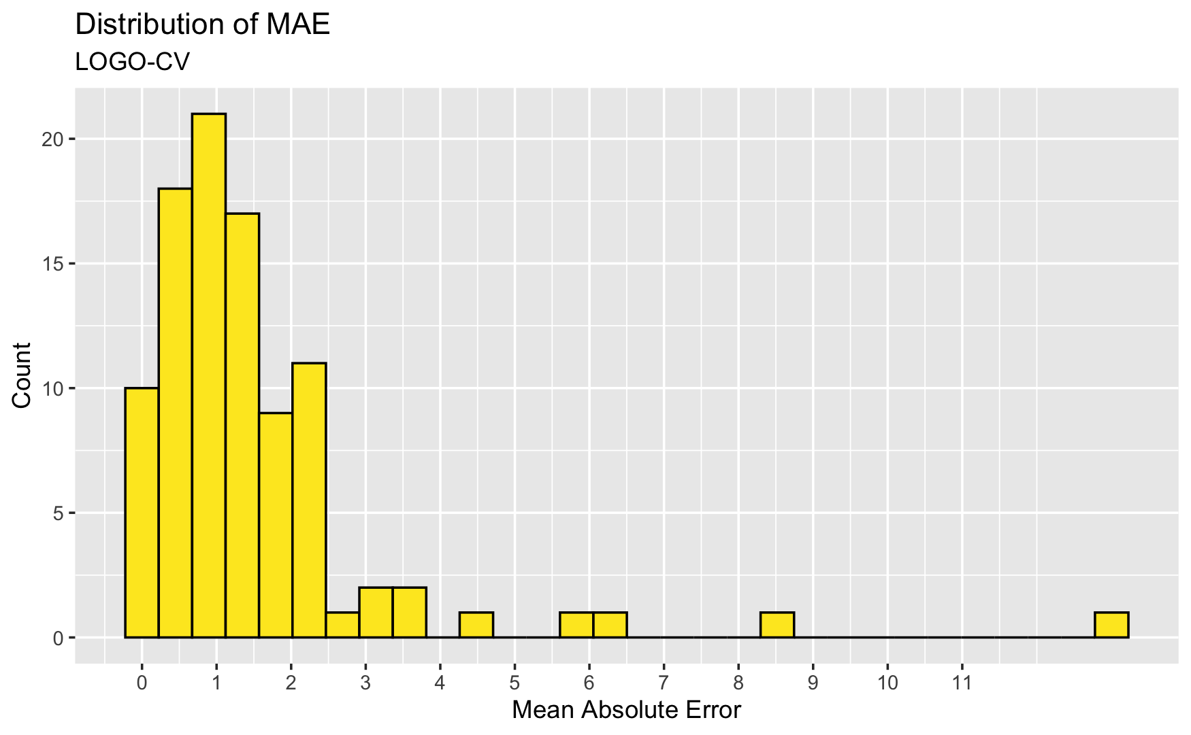
Geographic Cross-Validation
Leave-One-Group Out

Slide 16
A Primer on Logistic Regression (up next)

Slide 17
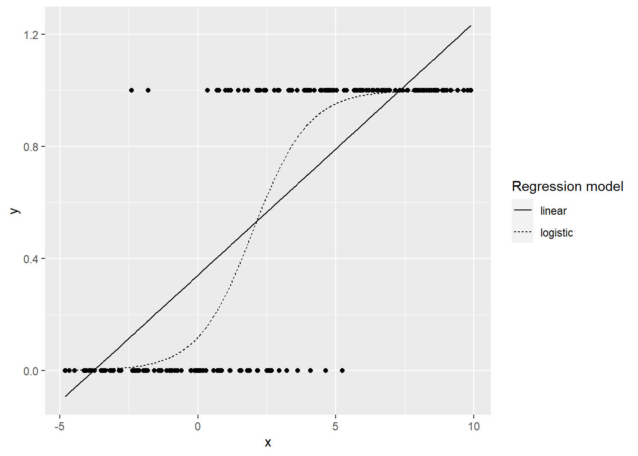
Logistic Regression
When you have a binary outcome variable.
Predict: positive (1) or negative(0)
Tries to guess the probability of belonging to one group or another.
Extension of linear regression.
The predicted value is a probability between 0 and 1.

Slide 18
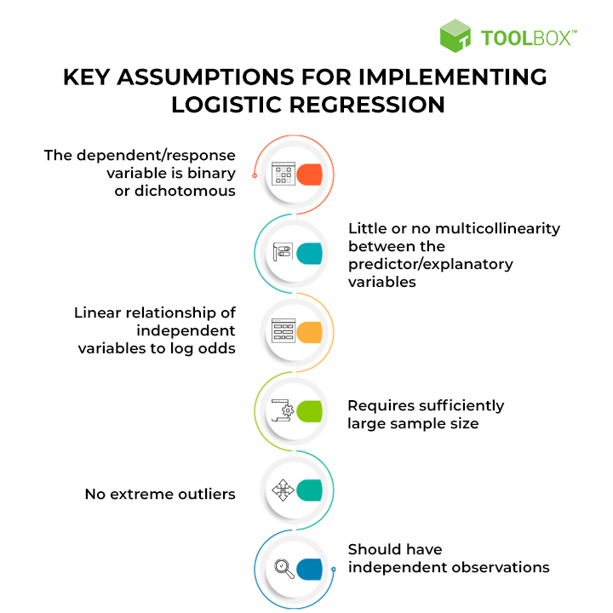

Slide 19
Logistic Regression Predicts a Probability of the Default Class.
We must then convert it into a binary value (0,1) to make class predictions.

Slide 20
Fitting the model
The coefficients (Beta values b) of the logistic regression estimated from training data use maximum likelihood.
Best coefficients = model that predicts value very close to 1 for the default class or very close to 0 for other.

